Slide 1
Dungeon Destroyer
Husain Patanwala (CS210)

Slide 2
General Overview
I am considering making a turn-based RPG style game called “Dungeon Destroyer”. The main premise of the game is to traverse through the map which will be implemented using a graph, and the player has to battle monsters in turn-base combat. To learn new skills, players must unlock items on the skill with loot/gold earned from fights. Certain skills will be more effective against certain monsters, and thus, players will have to focus on unlocking different parts of the skill tree to ensure they can pass levels. Also, user related info will be stored using hashmaps and lists, and the turn based system between player and ai enemies will be implemented using a queue. The end goal of the game is to reach the end of the map and defeat the boss. The story is still somewhat incomplete, but these are the general mechanics I would like to implement.

Slide 3
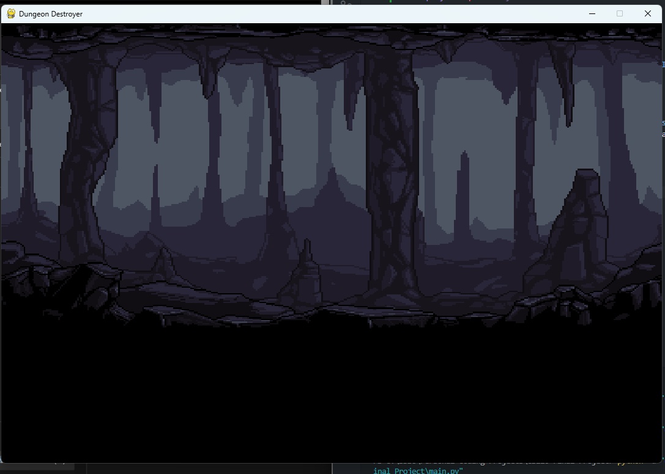
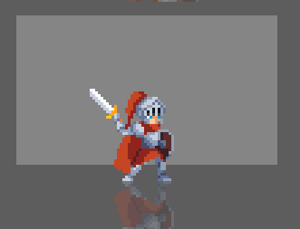
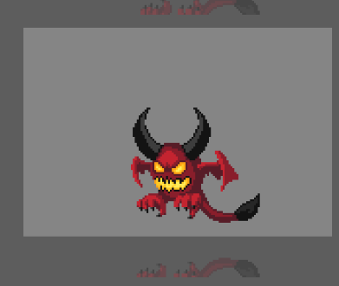
Initial game & assets

